Slide 1



Neutron beams and techniques for the measurement of neutron capture cross sections
J. Lerendegui-Marco, C. Guerrero and J.M. Quesada
Notes:
Sigue con el ,ogo de la U. Sevilla en todas las transparencias
Agnade mi nombre.
Pon mas abajo el pie de pagina para que “no te moleste” luego
USA “MASTER SLIDE” DESIGN, SI NO ES LA MUERTE!!!!
n_TOF en lugar de n_TOF

Slide 2
Neutron Induced Reactions
?
Neutron radiative capture
Elastic/Inelastic
scattering
γ
γ
γ
γ
γ
Fission
γ
Many others:
(n,ch),
knock-out,
spallation, …..

Slide 3
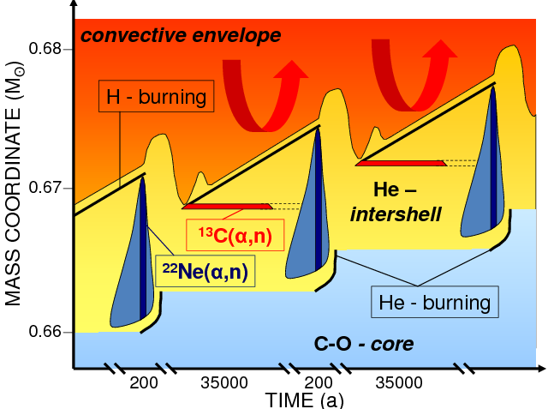
Interest for neutron capture measurements
Nuclear Astrophysics: s-process
Nucleosynthesis of elements A>60
Site: He-intershell in AGB stars (red giant)
Branching point: β⁻ decay competes with (n,γ)
Suff. long τ_{1/2} || Suff. High Φ_{n}
(n,γ)
(n,γ)
(n,γ)
β⁻ decay
Z
β⁻
β⁻
Stable
(n,γ)
(n,γ)
(n,γ)
(n,γ)
Branching point s-process
¹⁷¹Tm (n,γ)
N
σ(n,γ) input from nuclear data + ratio of chemical abundances→
bounds the temperature and neutron flux in stellar models
Notes:
What you call B6D6 #2 was the NaI, no?

Slide 4
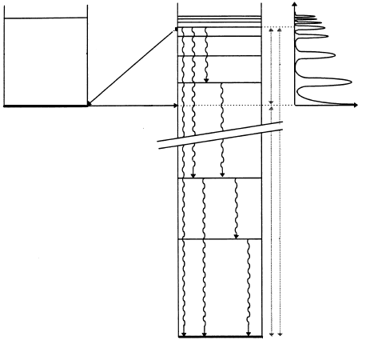
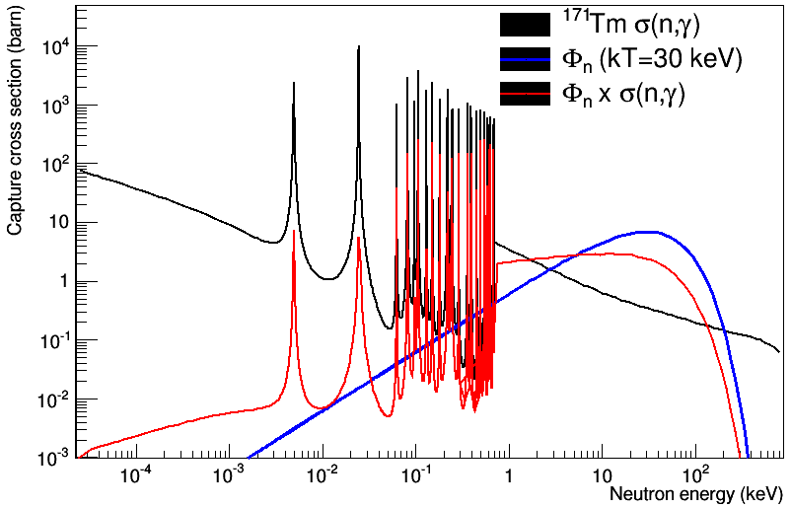
¹⁷¹Tm (n,γ): Energy ranges and beams
E
E_{c}
n
Maxwell
Boltzmann
distribution
@ K_{B}.T=30keV
S
n
+n
σ_{γ}
A
X
E_{c}
MACS:
Maxwellian
Averaged
Cross
Section
p(⁷Li,n)⁷Be
  or D-T)
MACS and TOF soon @ HISPANOS-CNA
A+1
X
Nuclear reactor
(i.e TRIGA, BRR)
Activation→ σ_{th}
(single value)
NEUTRON CROSS SECTION MEASUREMENTS:
How to produce of neutrons in each energy range
How to measure neutron energy and detect the reaction products
Pulsed white n-beam
(i.e. n_TOF@CERN, etc.)
Time-of-flight
→ pointwise σ(n,γ)
“quasi-Mawellian” n-beam
(i.e. FZK, LiLiT, FRANZ, etc.)
Activation→ MACS
(single value)
4
Notes:
What you call B6D6 #2 was the NaI, no?

Slide 5

Interest for neutron capture measurements
¹⁷¹Tm (n,γ): a European trip towards the thermal, resonance and MACS cross sections
3) Activation: thermal reactor
TRIGA Mainz
2) Separation and samples
(n,γ)
BRR
(n,γ)
PSI
(n,γ)
6) Activation: thermal reactor
1) Irradiation of Er-170 seed
β⁻ decay
CERN
ILL
β⁻
β⁻
Stable
(n,γ)
(n,γ)
(n,γ)
(n,γ)
4) TOF + white n beam:
Pointwise cross section
Branching point s-process
U. Sevilla
5) Activation:
Quasi-stellar spectra
Coordination and analysis
LiLiT
Notes:
What you call B6D6 #2 was the NaI, no?

Slide 6
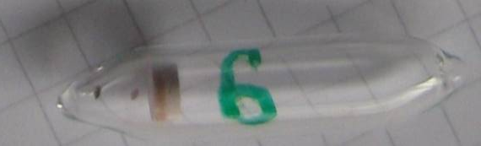
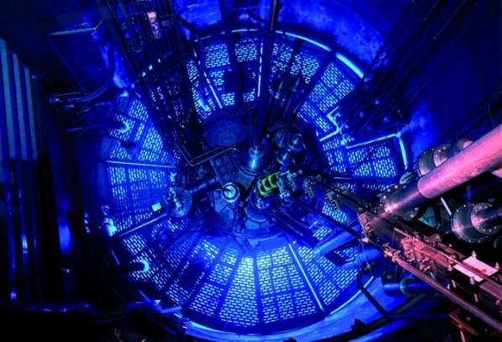


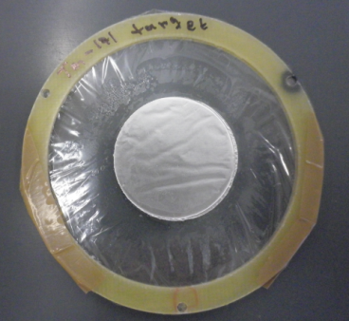
Preparation of
radioactive targets
Production via (n,g) or (n, g)+b⁻ at the ILL research reactor [Contact: Ulli Koester]
Neutron flux: 1.5x10¹⁵ n/cm²/s
Irradiation time: 55 days
--------------------------------------------------------------------------------
¹⁷¹Tm: ¹⁷⁰Er(n,γ)¹⁷¹Er(β⁻, 7.5h)¹⁷¹Tm (enrichment 1.8%)
~3.6 mg of ¹⁷¹Tm (1.9 y) [1.3 10¹⁹ atoms]
Assembly
mounted
Do not exist in nature→ Small masses produced
Activity challenge to handle and measure
Chemical separation and targets @ PSI [Contact: Stephan Heinitz]
¹⁴⁷Pm deposit (20 mm diameter)
Aluminum (7 μm) backing
PCB frame (50 mm diameter)
Mylar (5 μm)
Notes:
Pasar rapidito

Slide 7
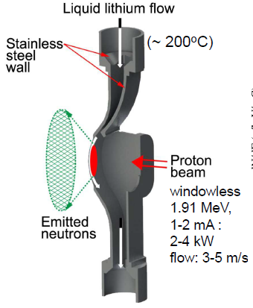
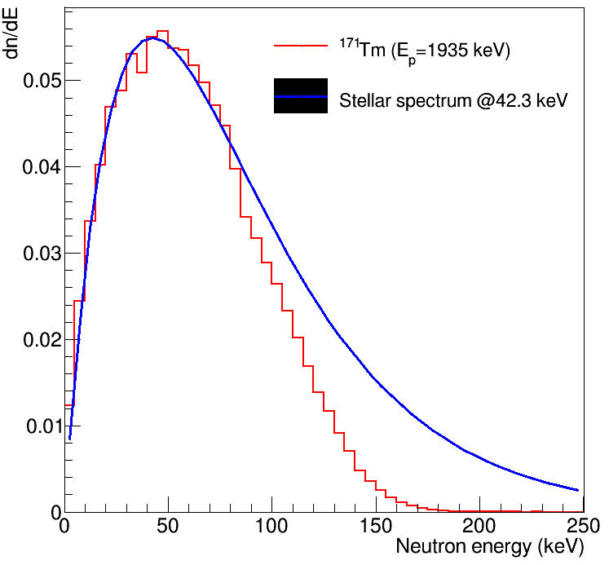
¹⁷¹Tm (n,γ): MACS measurement @ LiLiT
2x10¹⁰ n/s/mA
1-2 mA
~2 kW
2
Stellar
Experimental
Liquid Lithium Target (@SARAF, Israel)
Notes:
Pasar rapidito

Slide 8
¹⁷¹Tm (n,γ):
Setup @ LiLiT facility
Liquid lithium: ⁷Li(p,n)
neutrons (~stellar distribution @42 keV)
~1.935 MeV protons
1-2 mA
Precise beam intensity and energy distribution depend on distance and angle coverage
~12 mm
25 mm
22 mm
¹⁹⁷Au-front
monitor
¹⁹⁷Au-back
monitor
Case1. ¹⁹⁷Au(n,γ)¹⁹⁸Au -> β⁻ decay with t_{1/2}=2.69 d -> E_{γ} = 412
Case2. ¹⁷¹Tm(n,γ)¹⁷²Tm -> β⁻ decay with t_{1/2}=2.65 d -> E_{γ} = 1093, 1387, 1529, 1608
NORMALIZATION
Notes:
Pasar rapidito

Slide 9
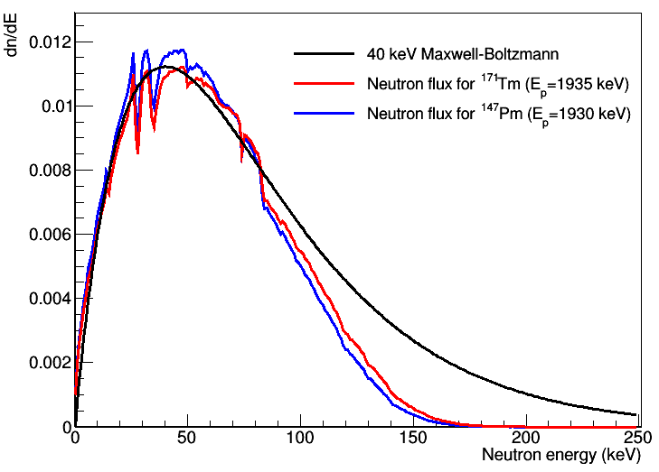
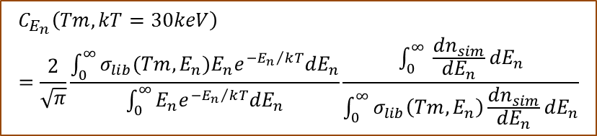
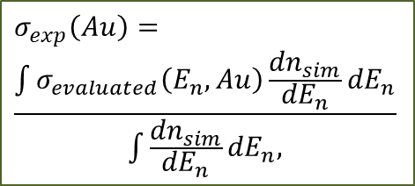
¹⁷¹Tm (n,γ): Activated nuclei to MACS
$$σ_{MACS}\left(Tm,kT=30keV\right)=\frac{2}{\sqrt{π}} C_{E_{n}}\left(Tm,kT=30keV\right){ σ}_{exp}(Au) \frac{{{N_{172Tm}}/{N_{171Tm}}}_{ }}{{N_{198Au}}/{N_{197Au}}}$$
$$C_{E_{n}}\left(Tm,kT=30keV\right)=\frac{2}{\sqrt{π}}\frac{\int_{0}^{∞}{σ_{lib}(Tm,E_{n}){E_{n}e}^{−{E_{n}}/kT}{dE}_{n}}}{\int_{0}^{∞}{{E_{n}e}^{−{E_{n}}/kT}{dE}_{n}}}\frac{\int_{0}^{∞}{ \frac{{dn}_{sim}}{{dE}_{n}}}{dE}_{n}}{\int_{0}^{∞}{σ_{lib}\left(Tm,E_{n}\right)\frac{{dn}_{sim}}{{dE}_{n}}}{dE}_{n}}$$
Measured quantity
$$σ_{exp}\left(Au\right)=$$
$$\frac{\int{σ_{evaluated}\left(E_{n},Au\right)\frac{{dn}_{sim}}{{dE}_{n}}}{dE}_{n}}{\int{\frac{{dn}_{sim}}{{dE}_{n}}{dE}_{n},}}$$
Correction for the shape of the flux and Tm171 eval.
x-section shape
Correction for the shape of the flux of the Au ref. MACS
Notes:
Pasar rapidito

Slide 10
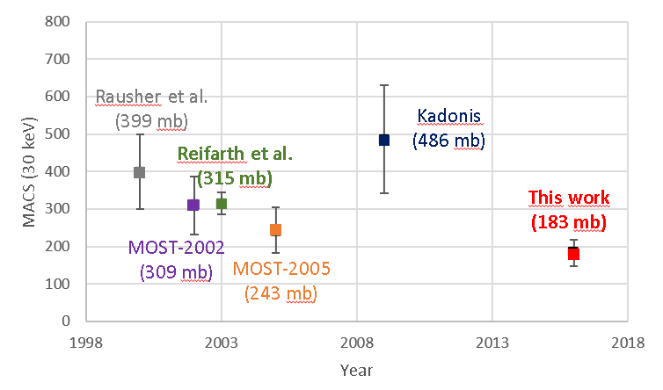
MACS results for ¹⁷¹Tm
σ_{MACS} (¹⁷¹Tm, kT=30 keV) = 183 (27*) mb
*Preliminary 15% uncertainty
This work
(183±27 mb)
x0,6
Significant reduction of the x-section following the trend of the n_TOF data
25% error bars for theoretical estimates
10

Slide 11
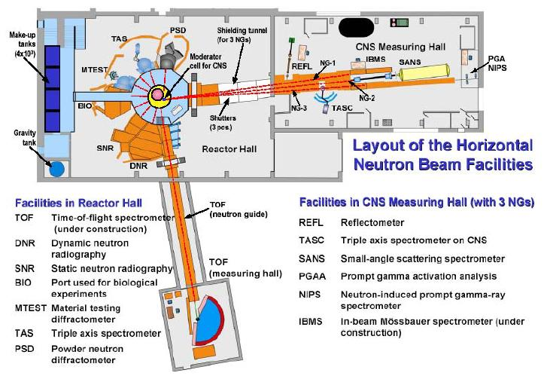
Thermal Cross-section measurement
Thermal cross-section:
Maxwellian spectra @ KT= 25meV
Prompt Gamma Activation Analysis using the n_TOF targets
MACS and thermal provide just two points:
TOF measurement needed for pointwise cross-section
Budapest Research Reactor
11
Notes:
Quita algo de información, me parece q está demasiado densa,

Slide 12
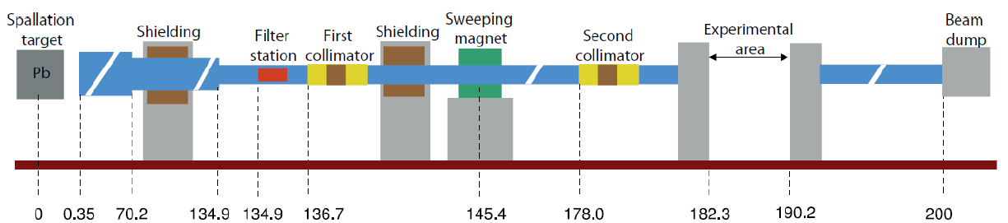
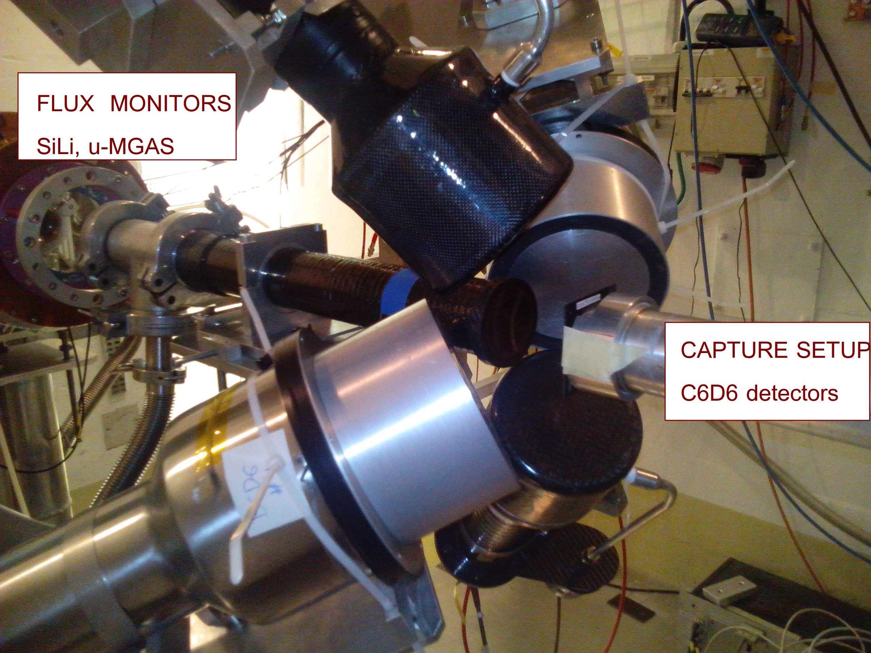
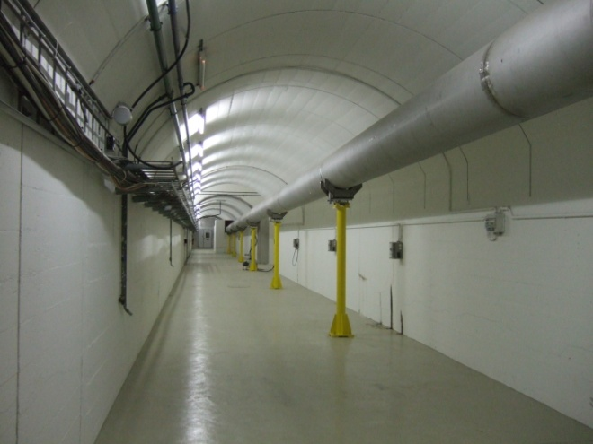
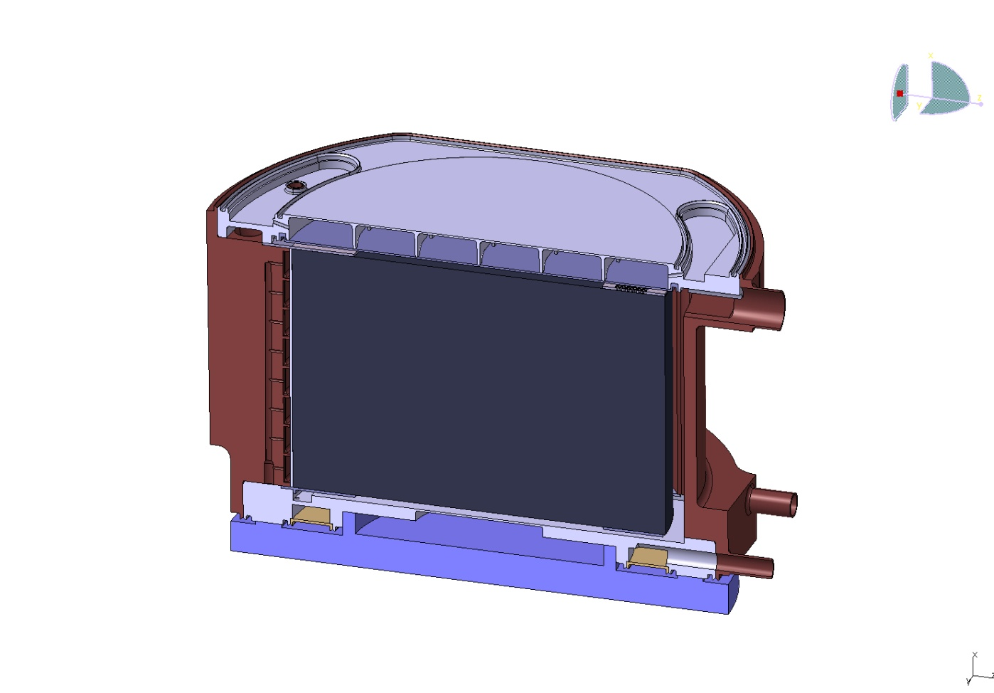
n_TOF: Time-of-flight technique
BEAM LINE EAR1
PS Proton
pulses
(20 GeV/c)
σ = 7 ns
γ
t
Pb
Spallation
MeV-GeV
Neutrons
t0
L= 184 m
Reaction products
Flux (Φ) (neutrons/cm²)
n_{at} (atoms/cm²)
Transmission
Neutrons (meV to GeV)
Scattering
5cm water moderator
Time-of-Flight to E_{n} relation (non-rel.):

Slide 13
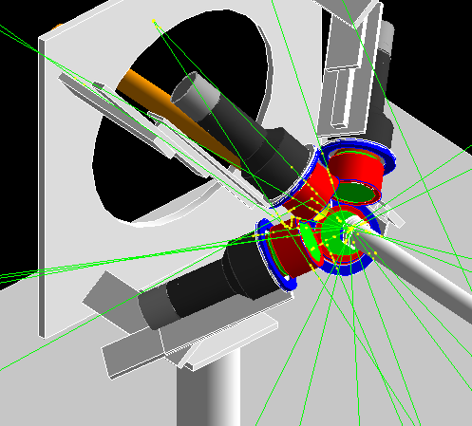
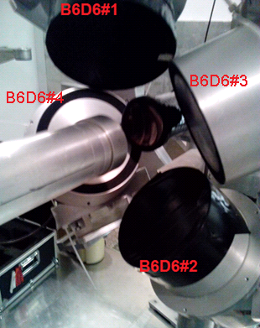
¹⁷¹Tm (n,γ) measurement
@ n_TOF
EAR1 using Total Energy Detectors
Geant4 model of the setup
PULSE HEIGHT WEIGHTING TECHNIQUE:
Accurate simulations required
Nov-Dec 2014
C₆D₆ Scintillators
Notes:
Pasar rapidito

Slide 14
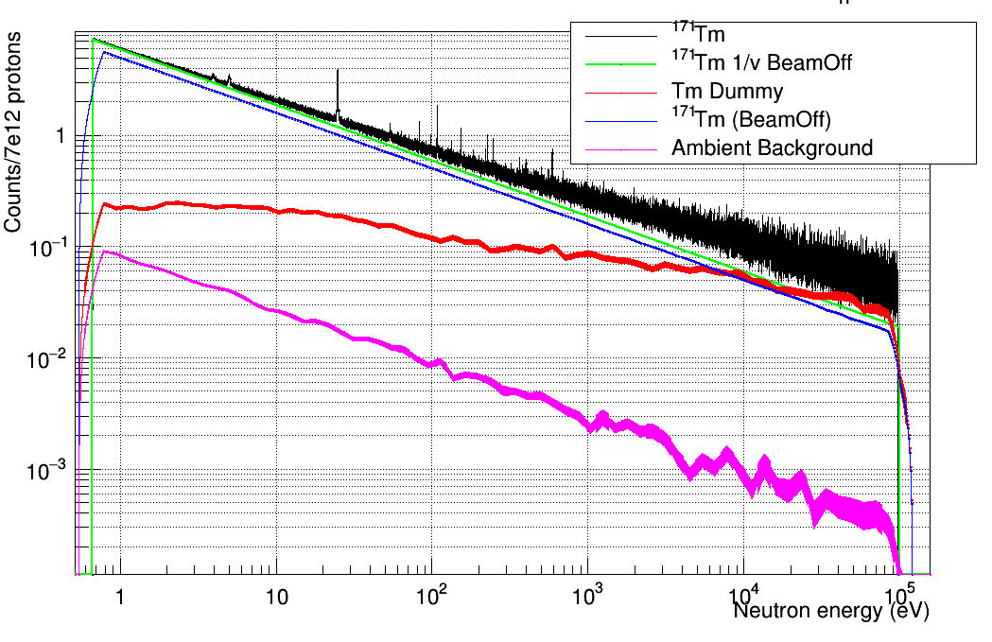
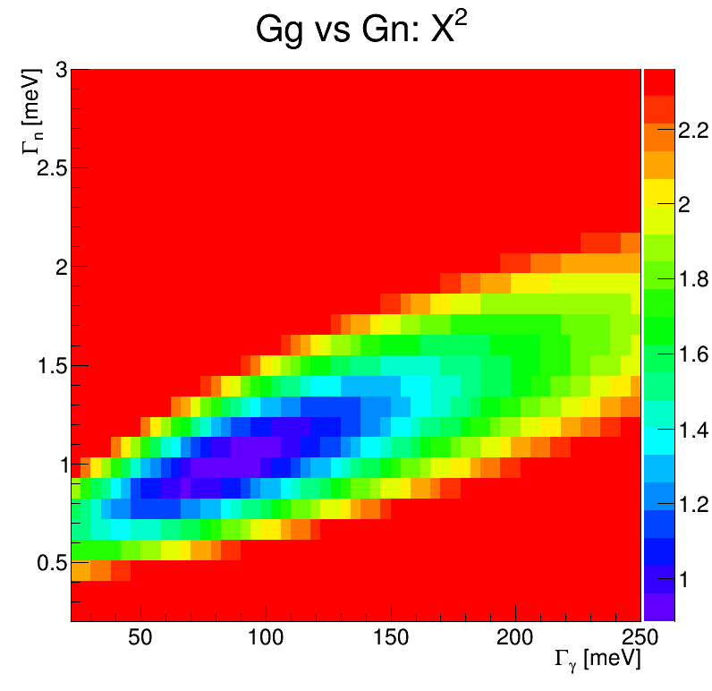
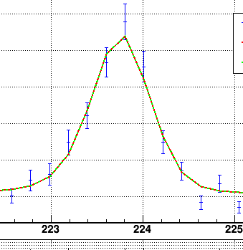
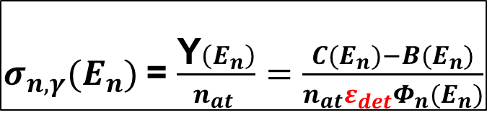
¹⁷¹Tm (n,γ) @ n_TOF
in brief
$σ_{n,γ}(E_{n})$= $\frac{\text{Y}\left(E_{n}\right)}{n_{at} }=\frac{C(E_{n})−B(E_{n})}{{n_{at}ε}_{det}Φ_{n}(E_{n})}$
Counts -> Pointwise
cross section
PHWT
Challenge:
Sample activity
Counts vs En
χ² (Γ_{n} vs. Γ_{γ})
Resonance analysis
Notes:
Pasar rapidito

Slide 15
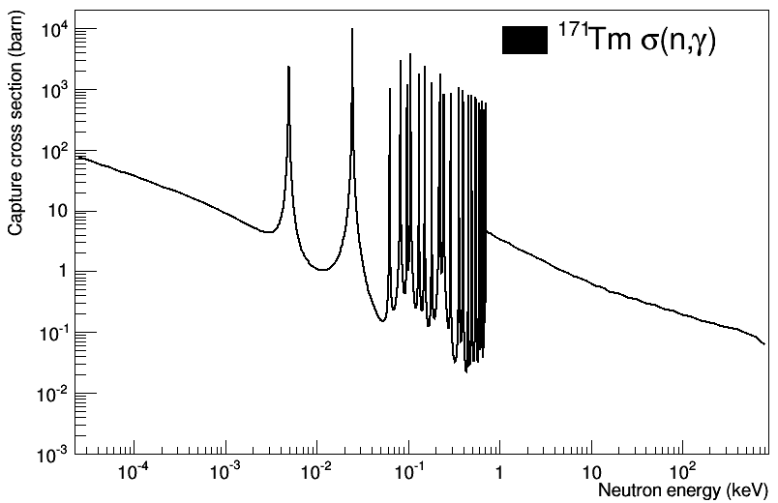
¹⁷¹Tm (n,γ): Extrapolating from the resonances
Significant reduction of x-section wrt systematic studies
Average resonance parameters
RRR:
Directly measured
(27 new resonances!)
URR: Extrapolated with these avg. parameters
Level Spacing: D₀
Neutron strenght:S₀
Avg. Radiative width: <Γ_{γ}>
Notes:
Pasar rapidito

Slide 16
Summary and conclusions
Radiative neutron capture cross sections are relevant for many applications
s-process: (n,g) cross-section certain isotopes key input for stellar evolution models
Tm-171 s-process branching point: Radioactive → Challenging production & measurement
Different neutron beams and techniques: Complementary energy ranges
n_TOF : White neutron beam produced via spallation protons in lead + partial moderation
Time-of-flight technique: Neutron energy from its time of flight (source <-> sample)
Pointwise cross section → Resonances and average parameters for URR
LiLiT @ SARAF : Quasi-stellar spectra ( Li-7(p,n)Be-7 reaction)
MACS measurement via activation → Decay of the produced Tm-172 nuclei
TRIGA (analysis ongoing) and BRR (near future): Maxwellian spectra at thermal
Measurement via activation and PGAA
Preliminary results indicate a significant reduction of x-section compared to models
16
Notes:
Agnade colores o espacios entre parrafos para que sea mejor
Menciona la no linearidad de los L6D6 en nuestro punto de operacion, y el rebote del 3-4%
“In the coming months the neutron sensitivity will“ -> “In the coming months the weighting functions and the neutron sensitivity will“

Slide 17
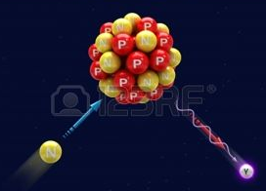
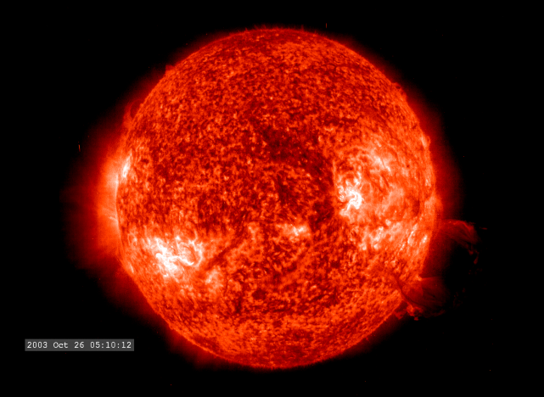
THANKS FOR YOUR ATTENTION!
16
Notes:
Agnade colores o espacios entre parrafos para que sea mejor
Menciona la no linearidad de los L6D6 en nuestro punto de operacion, y el rebote del 3-4%
“In the coming months the neutron sensitivity will“ -> “In the coming months the weighting functions and the neutron sensitivity will“

Slide 18
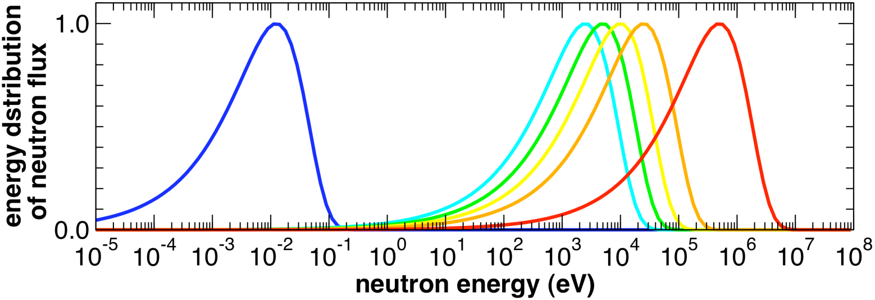
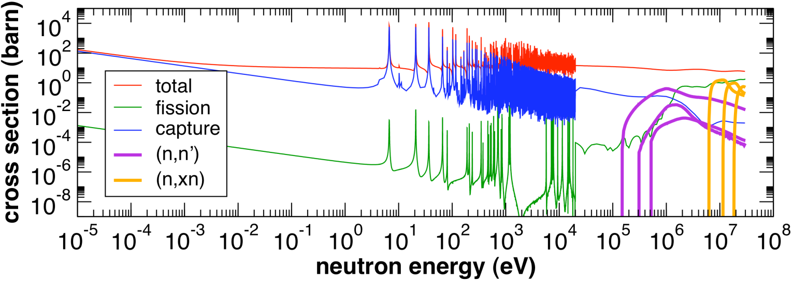
Neutron cross-sections:
Energies & applications
E
E_{c}
n
Maxwellian Stellar spectra
Wide range of energies
S
n
Fast reactors
+n
σ_{γ}
A
X
Water moderated
reactors
E_{c}
A+1
X
Contribution of many reaction channels.
Ex:²³⁸U
NEUTRON CROSS SECTION MEASUREMENTS:
How to produce of neutrons in each energy range
How to measure neutron energy and detect the reaction products

Slide 19
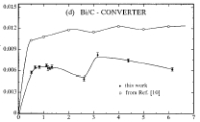




Total Energy Detection technique
Two conditions must be fulfilled:
I.) Low Efficiency Detectors:
II.) Efficiency to detect a γ-ray is proportional to
its energy: ε_{γi}$∝$E_{γi}
First idea: Moxon-Rae detectors:
Using a converter: maximum depth of escaping
electrons increases with E_{γ} …
Proportionality not really fulfilled
Sensitive to neutrons
ε_{γi} $≪$1, ∀i
m_{γ}
$$ε_{c}≈\sum_{i=1}{\text{ε}\text{γ}\text{i}}$$
ε_{C}
= 1 - Π (1 - ε_{γi})
E_{c}
E
n
i=1
S
n
σ_{γ}
thin scintillator
A
X
+n
Total efficiency depends on E_{c}
and not on the decay path
(γ,e⁻) converter
PM tube
E_{c}
$$ε_{c}=k\sum_{i=1}{\text{E}\text{γ}\text{i}}=kE_{c}$$
Bi/C-converter
-
ε_{γ} / E_{γ}
A+1
X
E_{γ}
Notes:
What you call B6D6 #2 was the NaI, no?

Slide 20
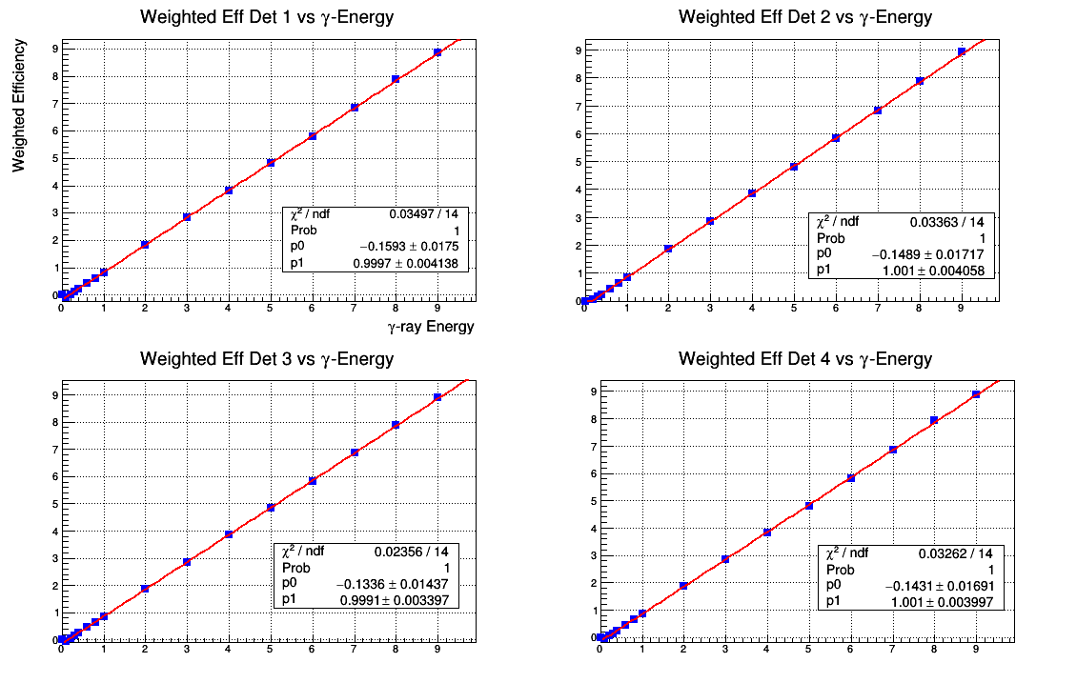
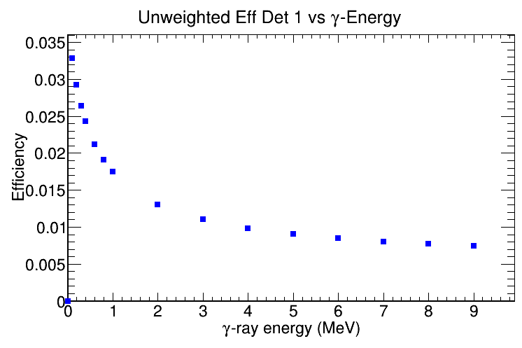
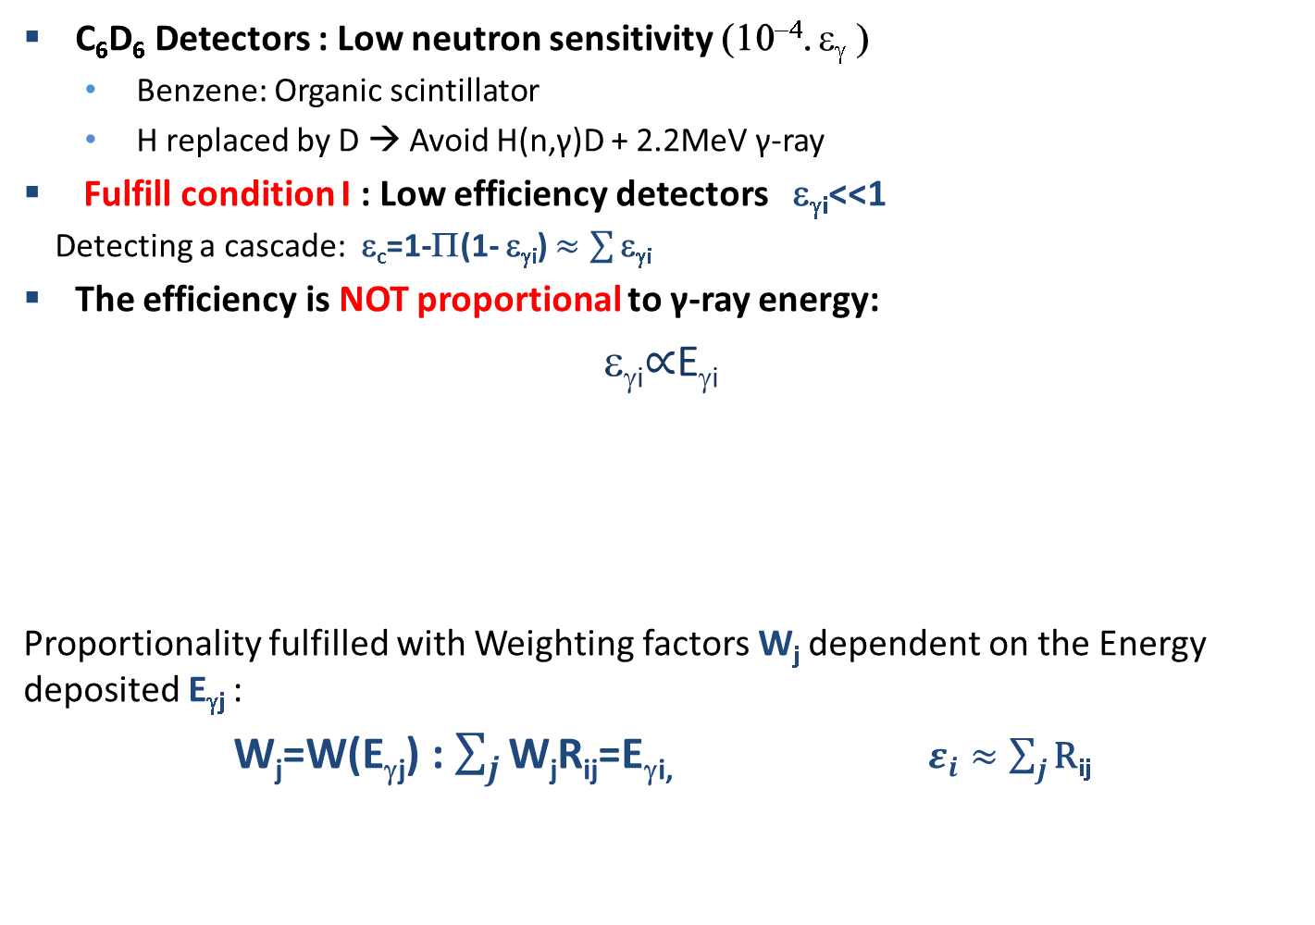
TED with C₆D₆ detectors
C₆D₆ Detectors : Low neutron sensitivity (10⁻⁴. ε_{γ} )
  Benzene: Organic scintillator
  H replaced by D → Avoid H(n,γ)D + 2.2MeV γ-ray
Fulfill condition I : Low efficiency detectors ε_{γi}<<1
Detecting a cascade: ε_{c}=1-Π(1- ε_{γi}) $≈\sum{\text{e}\text{g}\text{i}}$
The efficiency is NOT proportional to γ-ray energy:
ε_{γi}$∝$E_{γi}
Proportionality fulfilled with Weighting factors W_{j} dependent on the Energy deposited E_{γj} :
W_{j}=W(E_{γj}) : $\sum_{j}{\text{W}\text{j}\text{R}\text{ij}\text{=}\text{E}\text{g}\text{i}}$, $ε_{i}≈\sum_{j}{\text{R}\text{i}\text{j}}$
The proportionality between efficiency and γ-ray energy is obtained by software manipulation of the detector response (R_{ij})
Pulse Height Weighting Technique (PHWT)
k=1
Notes:
What you call B6D6 #2 was the NaI, no? The proportionality between efficiency and γ-ray energy is obtained by software manipulation of the detector response

